Slide 1
EN 410 Energy Management
Gurubalan Annadurai
guru.a@iitb.ac.in

Slide 2
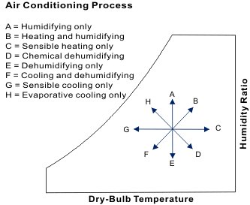
Psychometric process
How do estimate the energy transfer in each process
B and F are the major air conditioning process

Slide 3
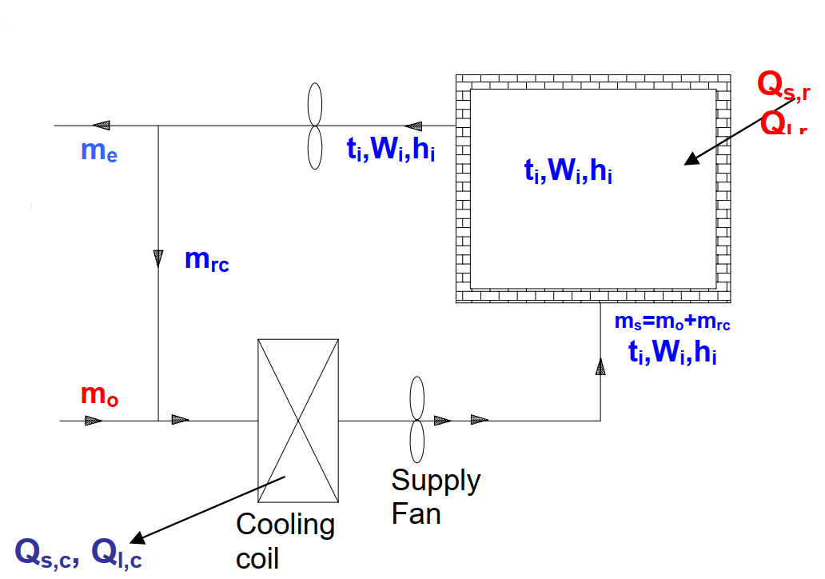
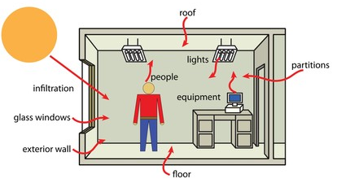
Summer Air Conditioning System
Sensible Load
Latent Load

Slide 4
Cooling and Dehumidification
Outdoor condition is 35℃, 50% RH
Indoor condition is 24℃, 50% RH
How to design your air conditioning system?

Slide 5
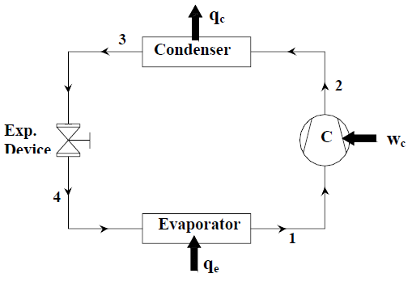
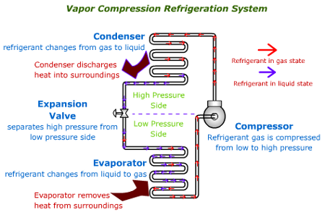
Vapor Compression Refrigeration system
A ton of refrigeration (1 TR) is defined as the amount of heat, which is to be extracted from one tonne of water at 0℃ in order to convert into ice at 0℃ in 24 hours (1 day).
1 TR = 210 kJ/min = 3.5 kW.

Slide 6
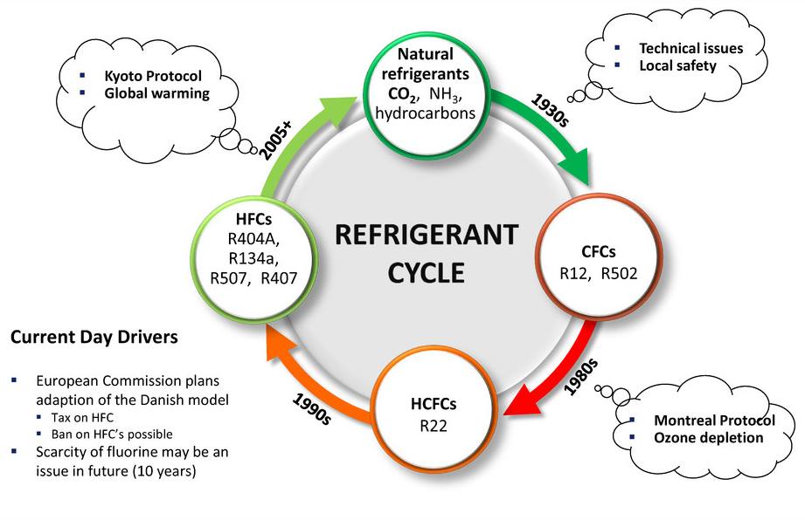
Refrigerants
REFRIGERANT | TYPE | ODP* | GWP*
R-12 | CFC | 0.820 | 10,600
R-22 | HCFC | 0.034 | 1,700
R-404A | HFC | 0 | 3,800
R-410A | HFC | 0 | 2,000
R-134a | HFC | 0 | 1,300
R-290 (Propane) | Natural | 0 | ~20
R-717 (Ammonia) | Natural | 0 | <1
R-1234yf | Unsaturated HFC | 0 | 4

Slide 7
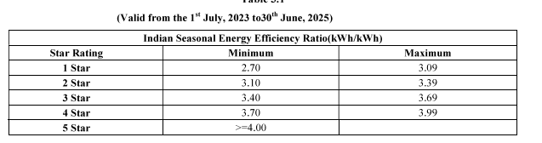
Estimate the energy demand (EER) of an air-conditioner
Inlet condition: DBT=20℃, WBT=14℃
Outlet condition: DBT=12.7℃, WBT=11.3℃
Capacity = 10 TR
Air flow rate = 4751 m³/hr
Power consumption = 4300 W

Slide 8
Strategies of Net Zero Buildings - Space Cooling
Reduce the room load
Reduce the system load
Meet the load by passive cooling methods

Slide 9
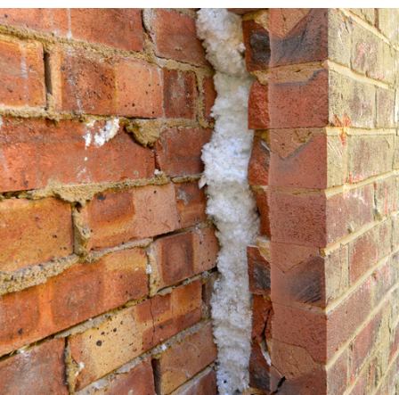
Reduce the room load
Insulation
Reasons to provide insulation.
Thermal Protection
Roof Load Distribution
Building Codes and Standards (IS 3792-1978)
Types of Wall Insulation Materials
Fiberglass
Mineral wool
Cellulose
Natural fibers
Polystyrene
Insulation facings
Polyisocyanurate
Polyurethane
Perlite
Cementitious foam
Phenolic foam

Slide 10
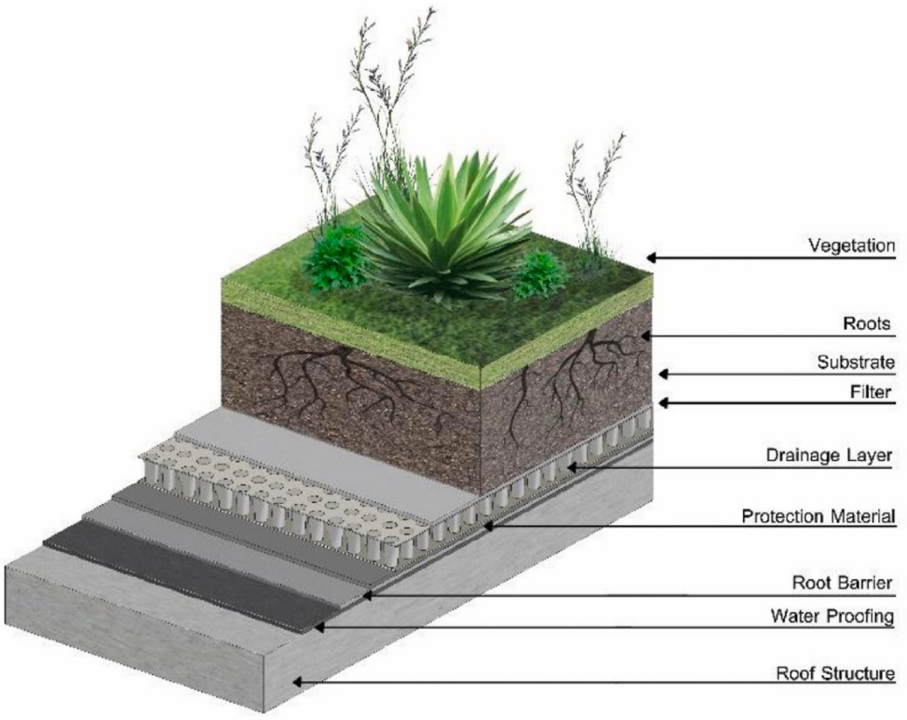
Reduce the room load
Green Roof
Green roof or living roof or Eco roof is a roof which is partially or completely covered with vegetation and a growing medium, planted over a waterproofing membrane.
Types of green roof systems
Single Course Extensive
Multi- Course Extensive
Semi Intensive
Intensive

Slide 11
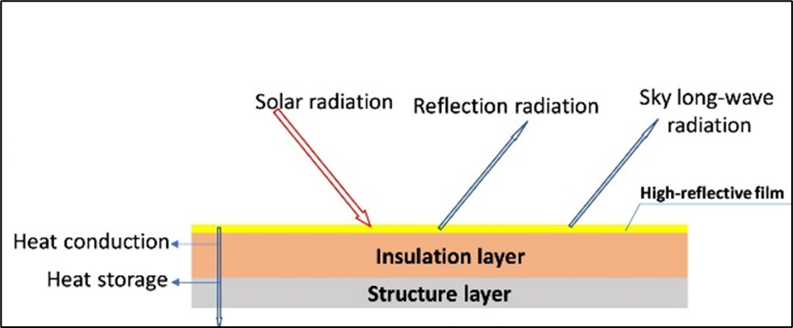
Reduce the room load
Cool Roof
Cool roofs are the roofs that can deliver high solar reflectance and high thermal emittance
Coatings Types
Acrylic based cool coats
Spray polyurethane cool coats
Polymer cool coats
Fiber Filled liquid cool coats

Slide 12
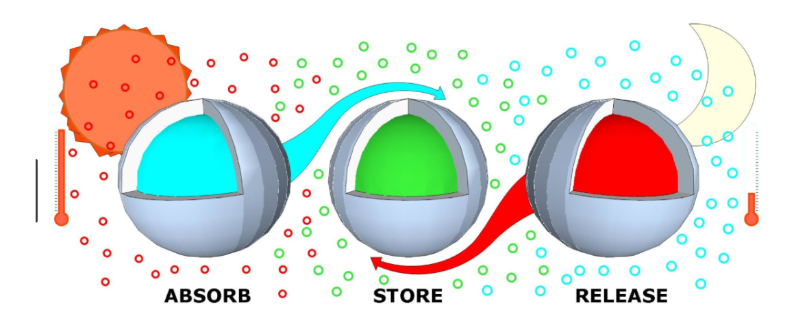
Reduce the room load
Phase Change Material
PCMs absorb and release heat, stabilizing indoor temperatures
Benefits include energy savings, improved comfort, and reduced emissions

Slide 13
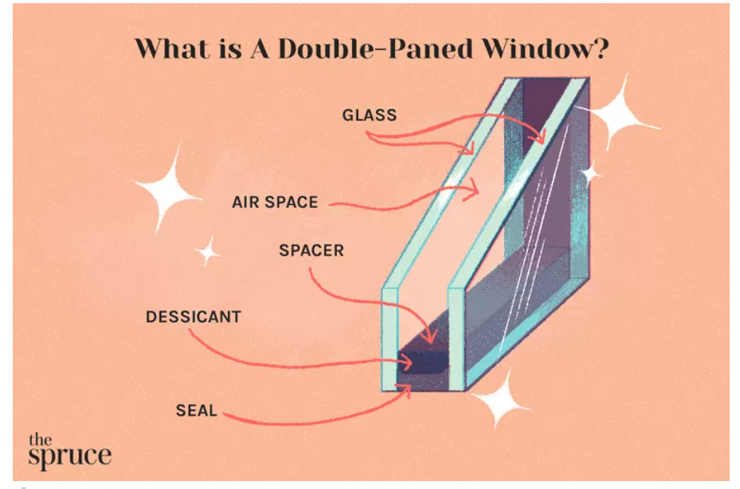
Reduce the room load
Double-Paned/Glazed Window
A double-paned window has two panes of glass set into a frame. Between the glass is an intervening gas or air pocket to better insulate a room.

Slide 14
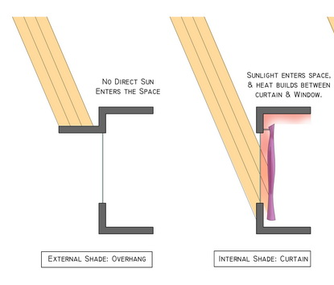
Reduce the room load
Shading

Slide 15
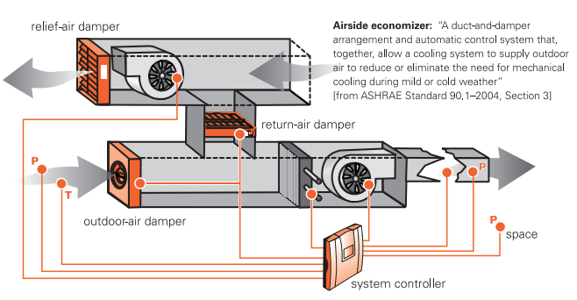
Economizer
Reduce the system load

Slide 16
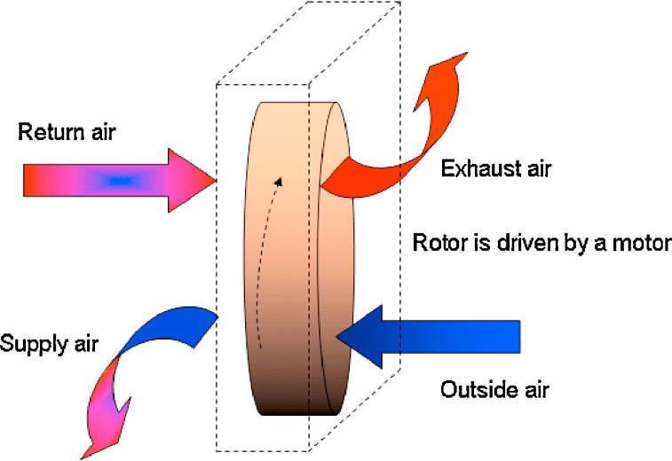
Energy Recovery Ventilator
Reduce the system load

Slide 17
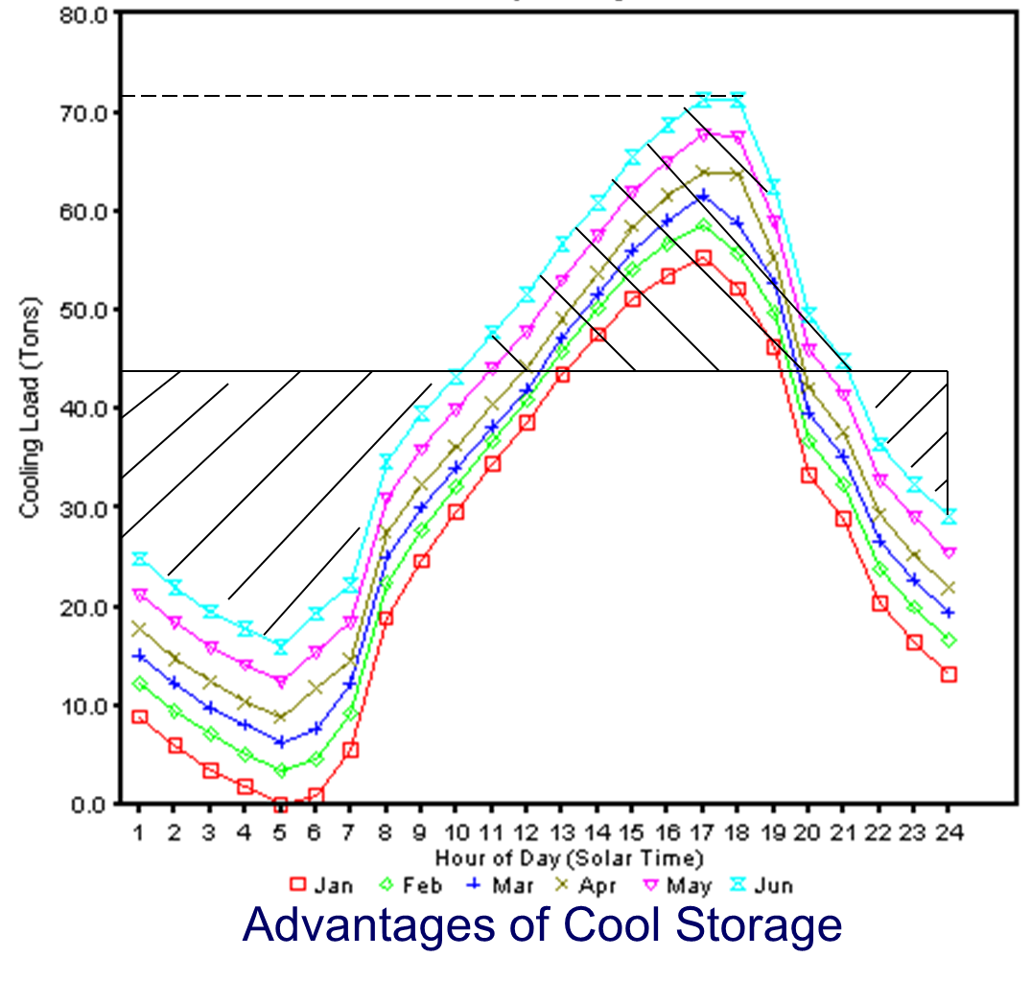
Cold Storage
Reduce the system load

Slide 18
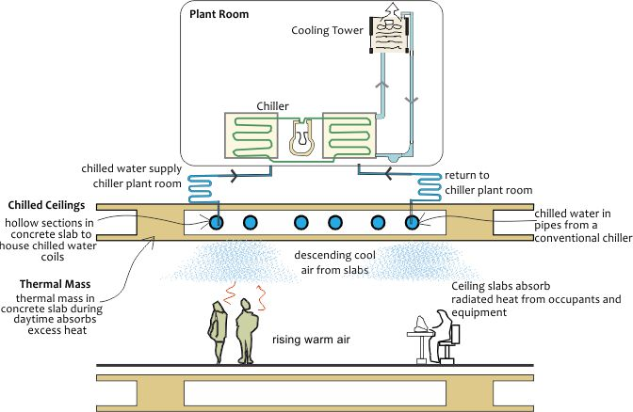
Radiant cooling system
Reduce the system load

Slide 19
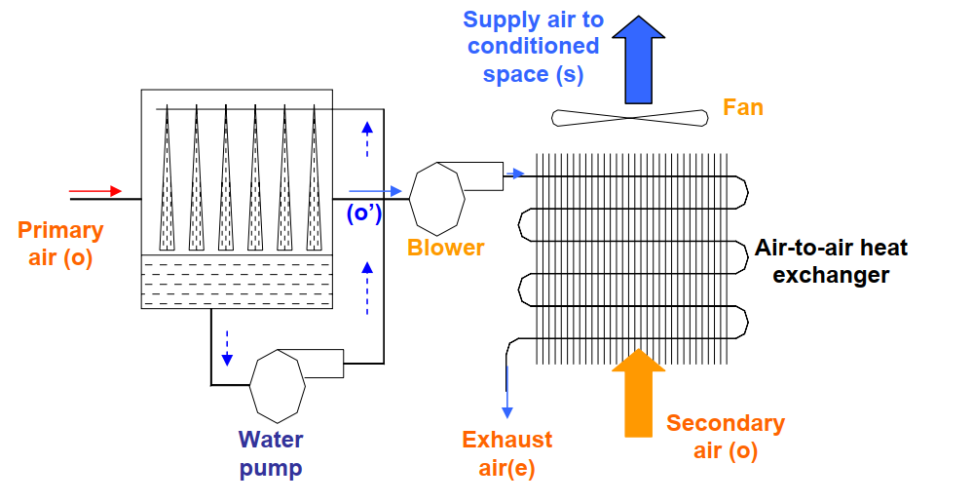
Evaporative cooling
Passive cooling

Slide 20
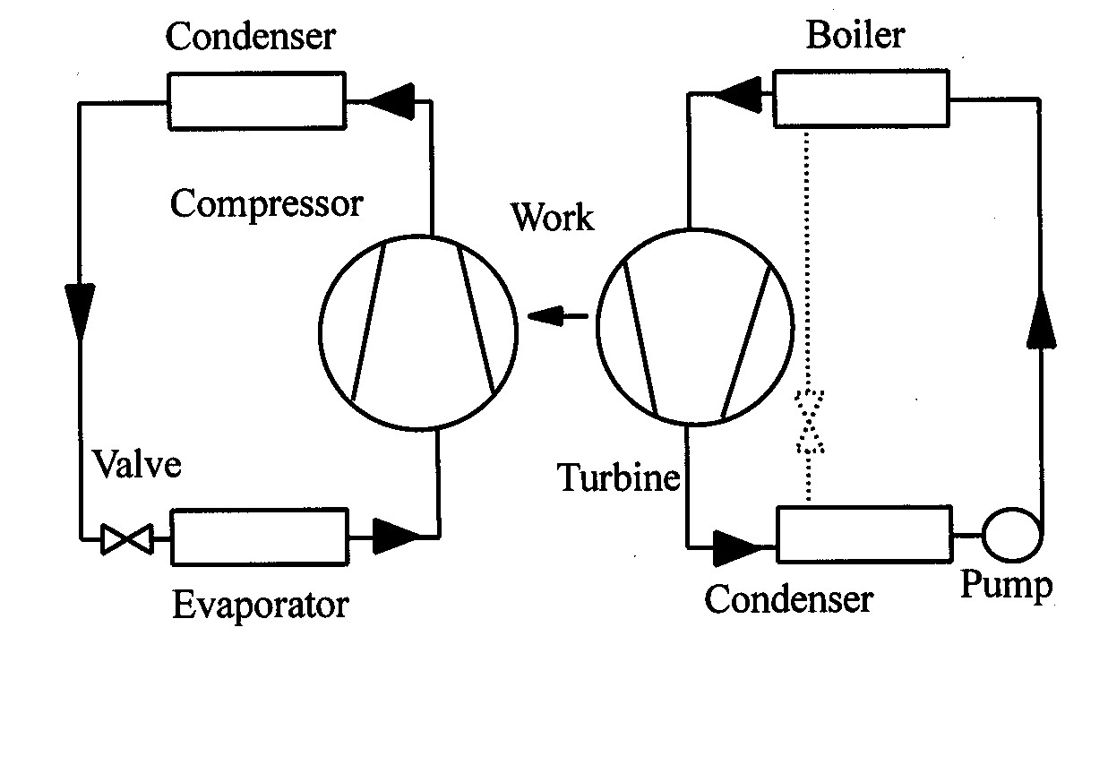
Vapor absorption system
Passive cooling
Working Pairs:
LiBr – H₂O ,
NH₃ – H₂O,
R134a - DMAC
Heat Exchanger
VCRS
Thermal
Power
Plant
Absorber
Thermal Compression

Slide 21
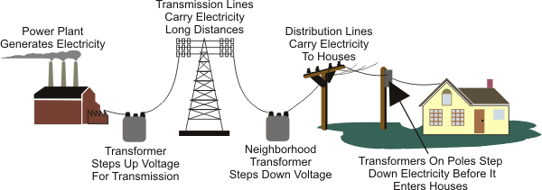
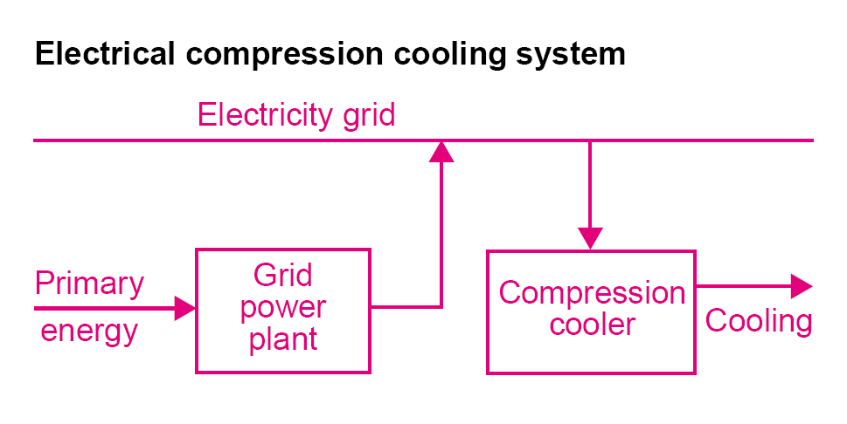

Vapor absorption system
Passive cooling
Power generation – Transmission – Compression Cooling
Expected losses in power lines
Power plant loss : 70%
(Efficiency = 30%)
Generator Loss : 5%
T &D Loss : 30%
End Equipment loss : 10%
25 kW – 7.5 kW – 6.75 kW – 4.75 kW – 4.25 kW
Heat Source to Site Power Factor: 4.25/25 = 0.17

Slide 22
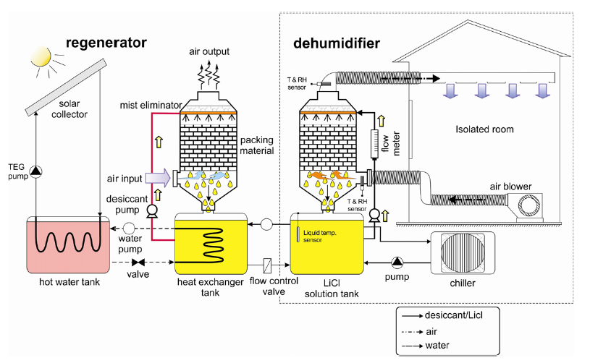
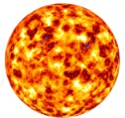
Liquid desiccant cooling system
Passive cooling

Slide 23
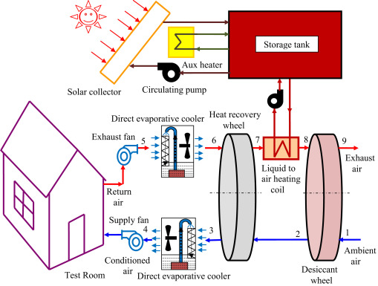
Solid desiccant cooling system
Passive cooling

Slide 24
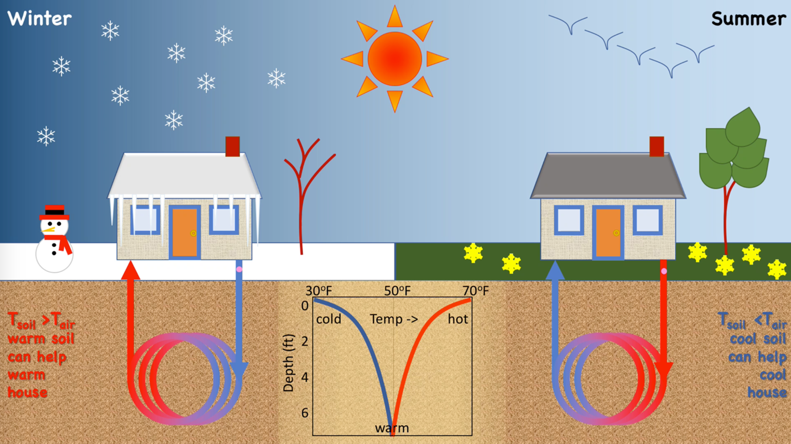
Geothermal cooling
Passive cooling

Slide 25
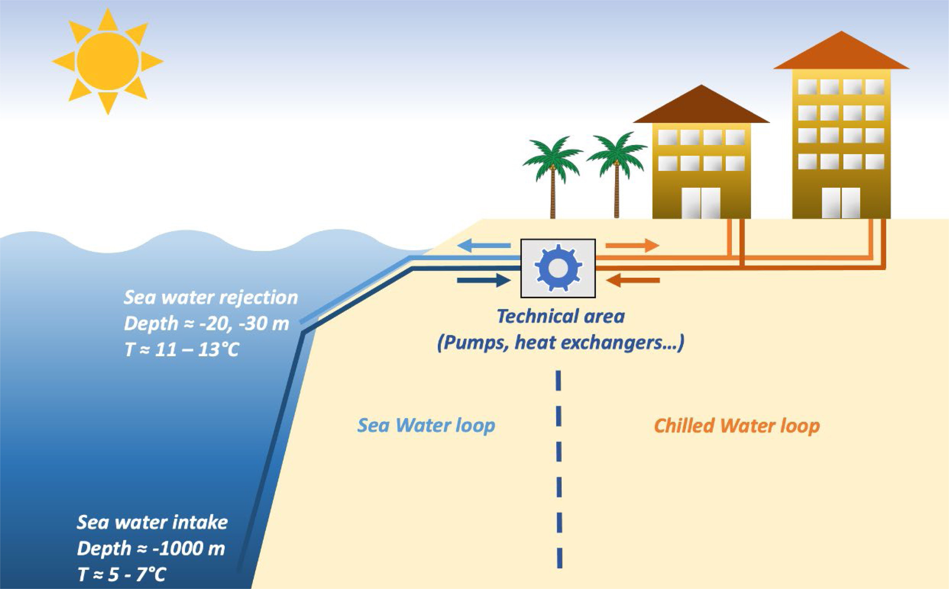
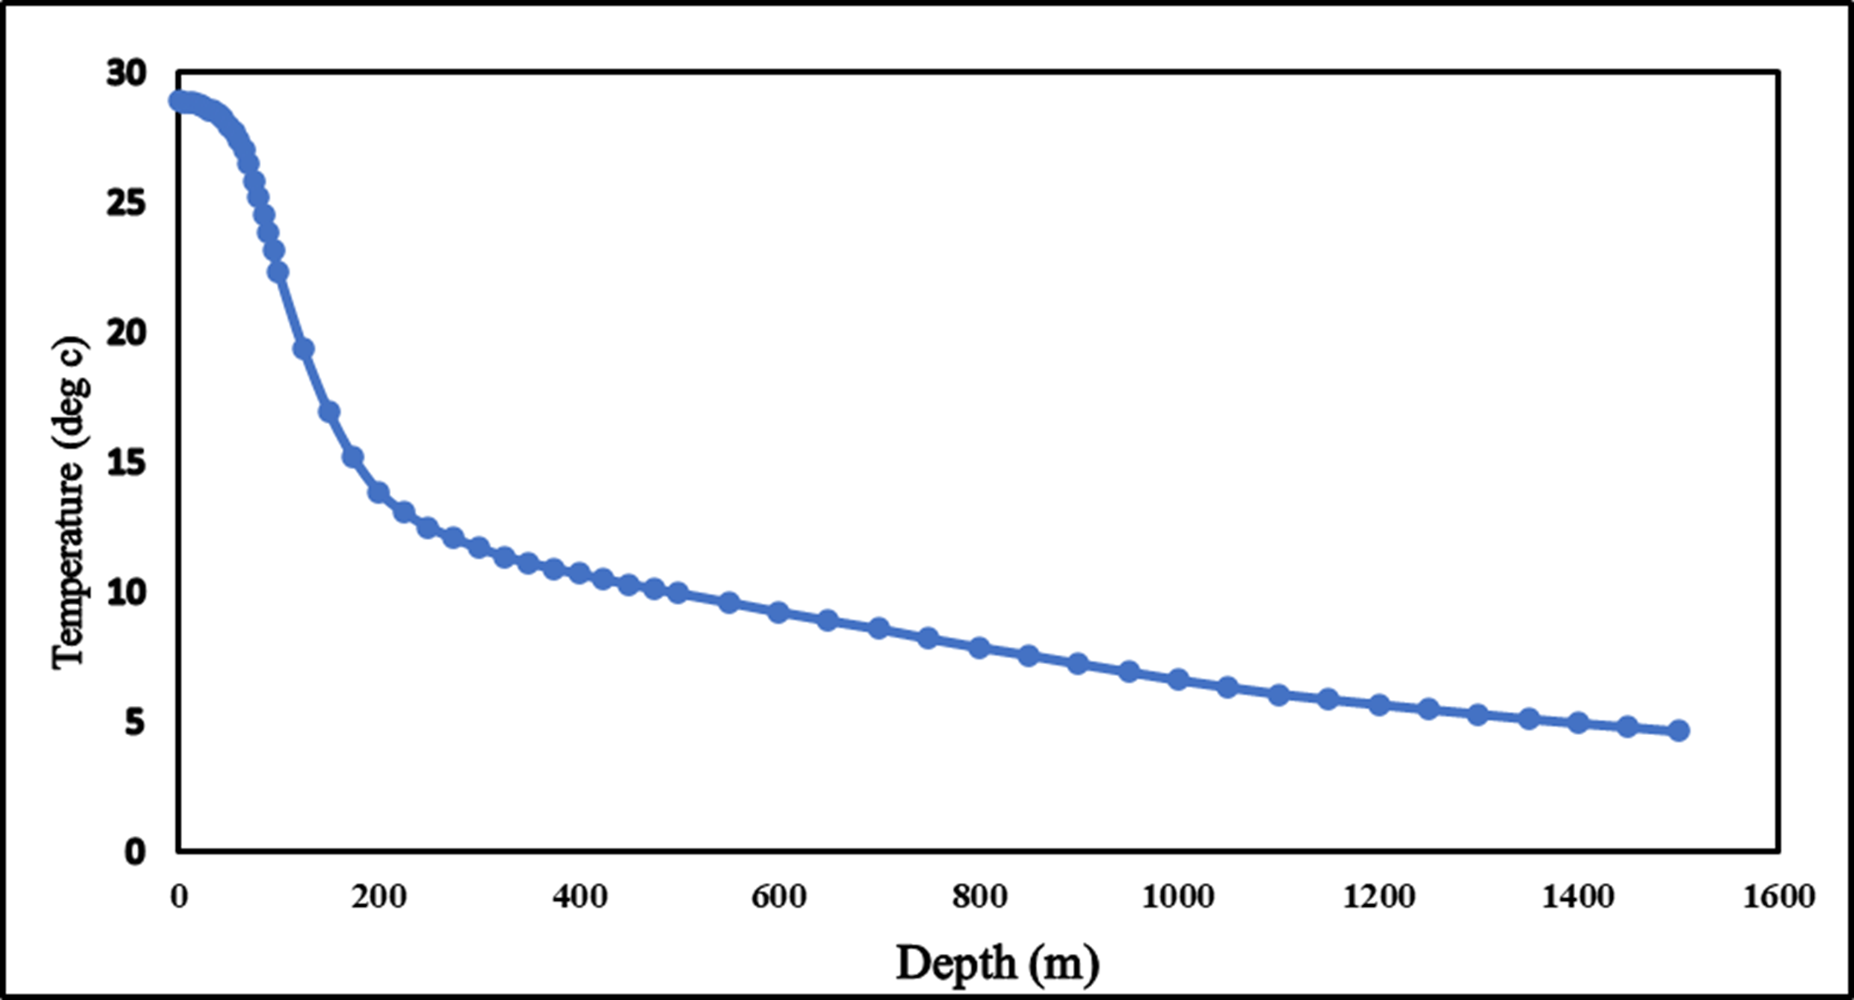
Passive cooling
Deep Sea Water Cooling System

Slide 26
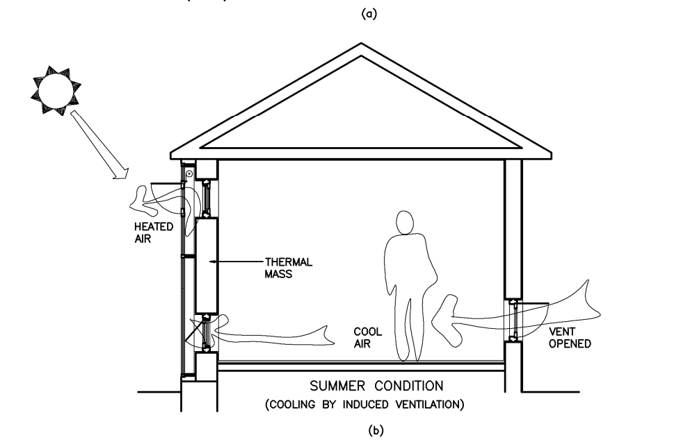
Ventilation cooling
Trombe wall / Solar chimney

Slide 27
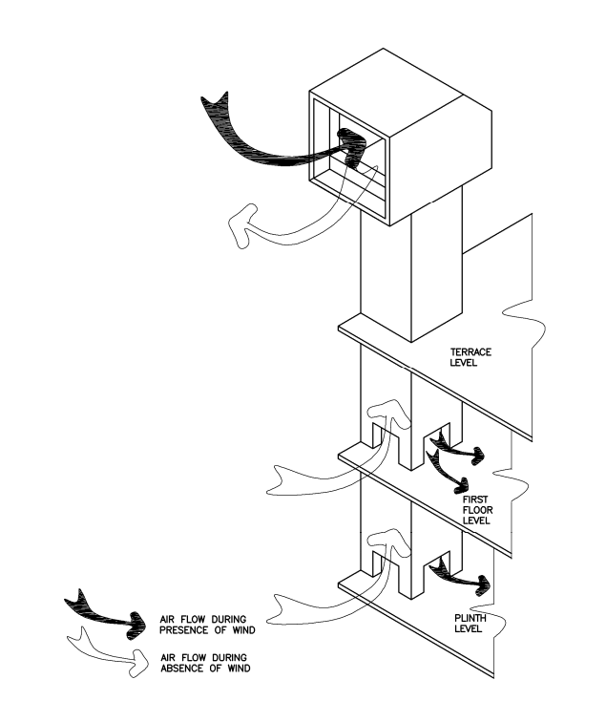
Wind tower
Ventilation cooling

Slide 28
References
https://www.trane.com/content/dam/Trane/Commercial/global/products-systems/education-training/engineers-newsletters/airside-design/admapn020en-0406.pdf
https://nzeb.in/knowledge-centre/hvac-2/radiant-cooling-systems/
NPTEL, Mechanical Engineering - Refrigeration and Air Conditioning
https://archive.nptel.ac.in/courses/112/105/112105129/
Karthik Panchabikesan, Kumaresan Vellaisamy, Velraj Ramalingam, Passive cooling potential in buildings under various climatic conditions in India, Renewable and Sustainable Energy Reviews, Volume 78, 2017, Pages 1236-1252,
https://climate.earthathome.org/sunlight-stored-in-soil/
https://fairconditioning.org/knowledge/passive-design/shading/
https://www.sciencedirect.com/science/article/pii/S1364032116002665#f0010

